Slide 1
AVL Trees
Adelson- Velsky - Landis

Slide 2
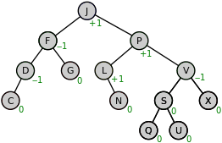
AVL Tree
AVL tree is a self-balancing binary search tree.
In an AVL tree, the heights of the two child subtrees of any node differ by at most one; if at any time they differ by more than one, rebalancing is done to restore this property.
The given tree is AVL because differences between heights of left and right subtrees for every node is less than or equal to 1

Slide 3
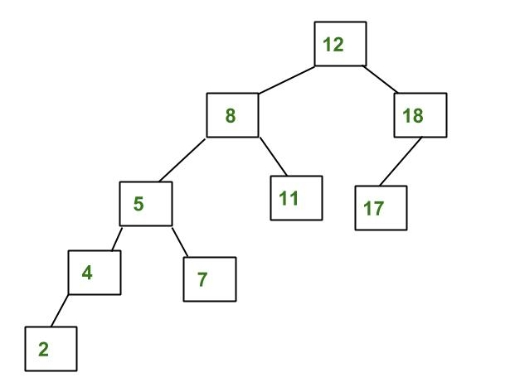
The above tree is not AVL because differences between heights of left and right subtrees for 8 and 18 is greater than 1
Why AVL Trees?
Most of the BST operations (e.g., search, max, min, insert, delete.. etc) take O(h) time where h is the height of the BST. The cost of these operations may become O(n) for a skewed Binary tree.
If we make sure that height of the tree remains O(Logn) after every insertion and deletion, then we can guarantee an upper bound of O(Logn) for all these operations. The height of an AVL tree is always O(Logn) where n is the number of nodes in the tree.

Slide 4
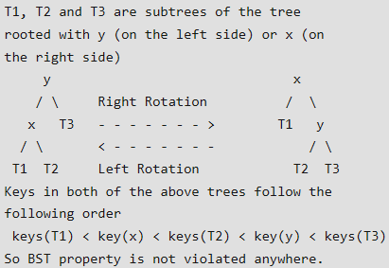
Insertion
To make sure that the given tree remains AVL after every insertion, we must augment the standard BST insert operation to perform some re-balancing.
Following are two basic operations that can be performed to re-balance a BST without violating the BST property (keys(left) < key(root) < keys(right)). 1) Left Rotation
2) Right Rotation

Slide 5
Steps to follow for insertion Let the newly inserted node be w 1) Perform standard BST insert for w.
2) Starting from w, travel up and find the first unbalanced node. Let z be the first unbalanced node, y be the child of z that comes on the path from w to z and x be the grandchild of z that comes on the path from w to z.
3) Re-balance the tree by performing appropriate rotations on the subtree rooted with z.
There can be 4 possible cases that needs to be handled as x, y and z can be arranged in 4 ways. Following are the possible 4 arrangements: a) y is left child of z and x is left child of y (Left Left Case) b) y is left child of z and x is right child of y (Left Right Case) c) y is right child of z and x is right child of y (Right Right Case) d) y is right child of z and x is left child of y (Right Left Case)
In all of the cases, we only need to re-balance the subtree rooted with z and the complete tree becomes balanced as the height of subtree (After appropriate rotations) rooted with z becomes same as it was before insertion.

Slide 6
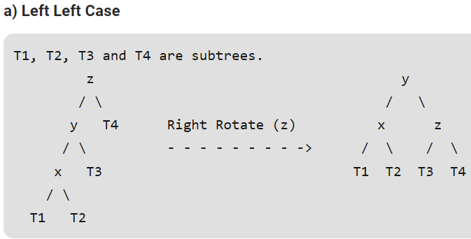
Following are the operations to be performed in mentioned 4 cases

Slide 7
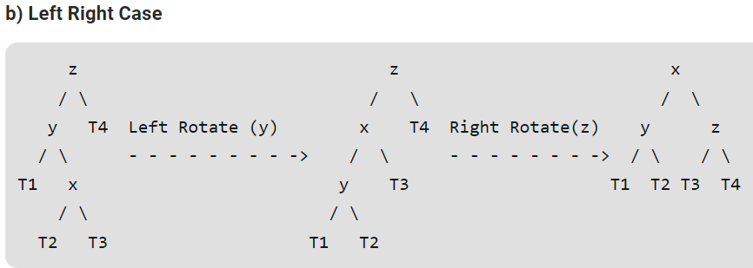

Slide 8
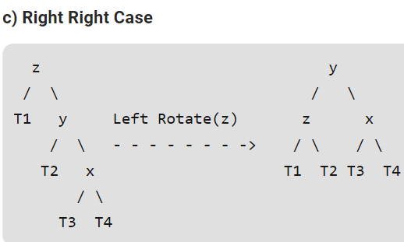

Slide 9
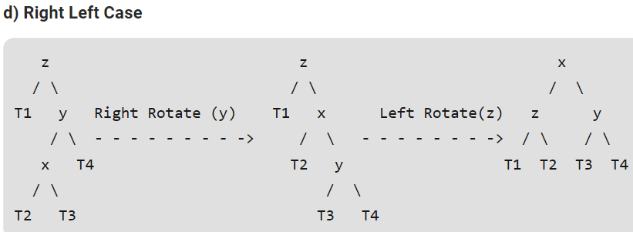

Slide 10
Following are the operations to be performed in above mentioned 4 cases

Slide 11
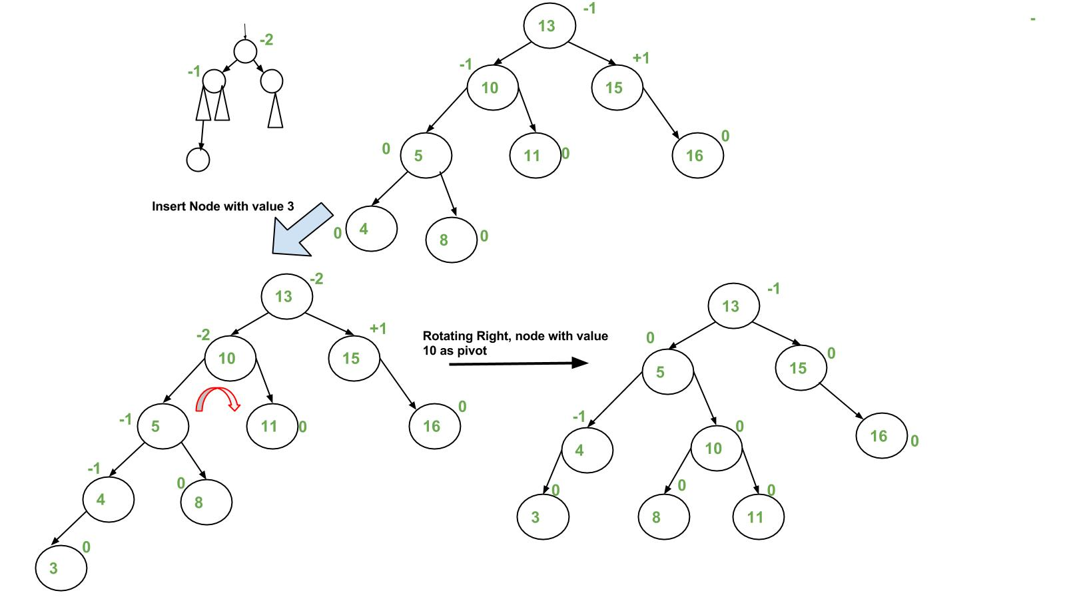

Slide 12
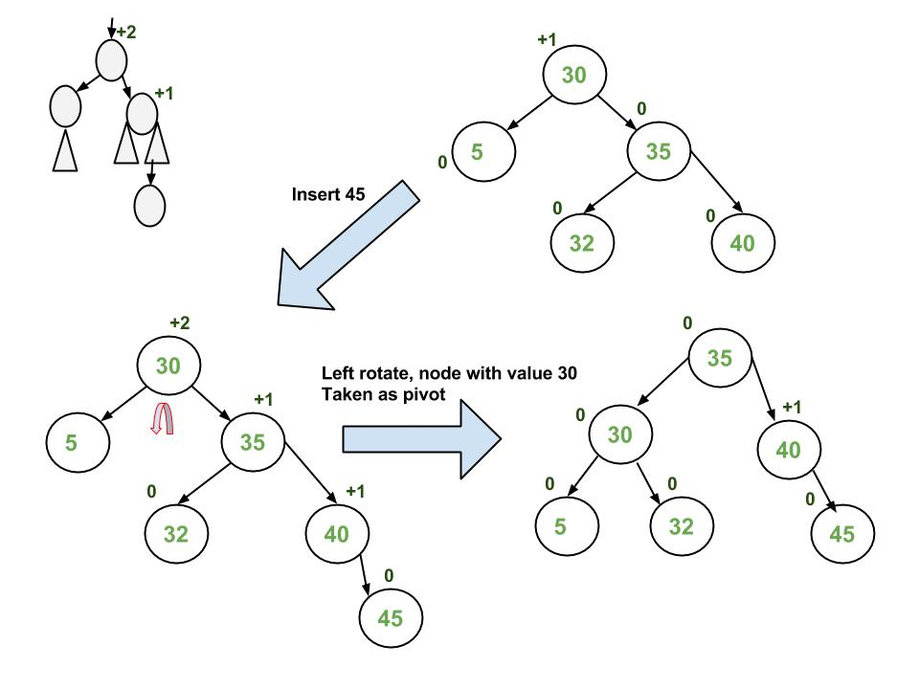

Slide 13
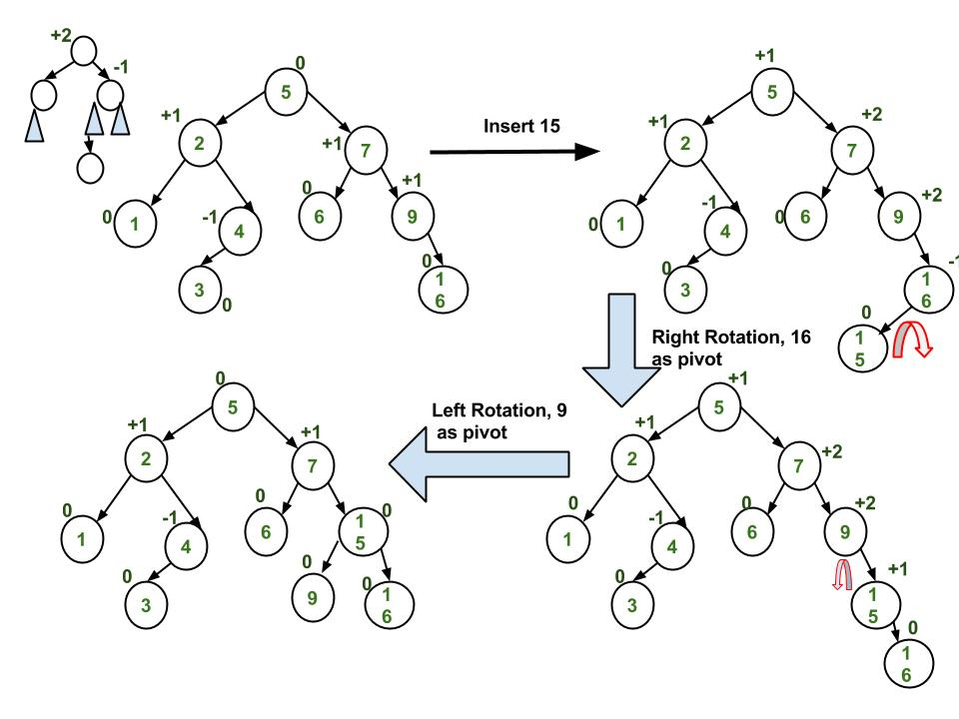

Slide 14
Deletion in AVL Tree
Deleting a node from an AVL tree is similar to that in a binary search tree.
Deletion may disturb the balance factor of an AVL tree and therefore the tree needs to be rebalanced in order to maintain the AVLness.
For this purpose, we need to perform rotations. The two types of rotations are L rotation and R rotation
Let us consider that, A is the critical node and B is the root node of its left sub-tree. If node X, present in the right sub-tree of A, is to be deleted, then there can be three different situations:

Slide 15
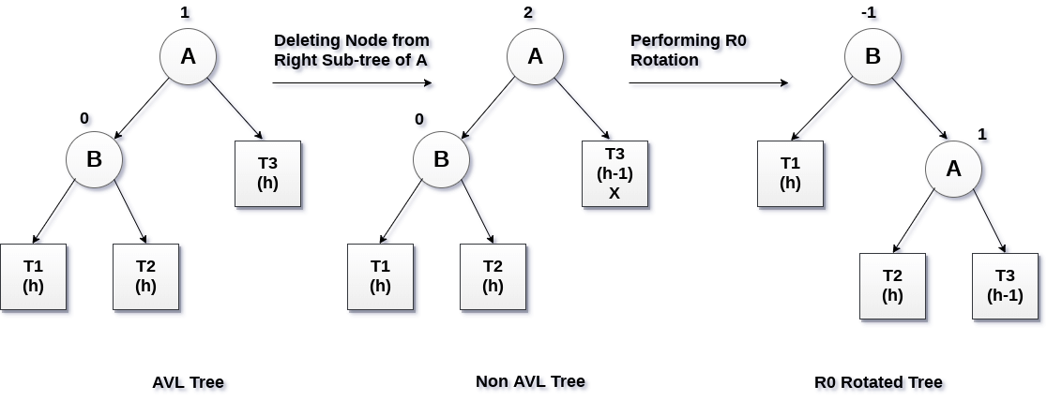
R0 rotation (Node B has balance factor 0 )
If the node B has 0 balance factor, and the balance factor of node A disturbed upon deleting the node X, then the tree will be rebalanced by rotating tree using R0 rotation.
R0 → LL Case → Right Rotation at critical node

Slide 16
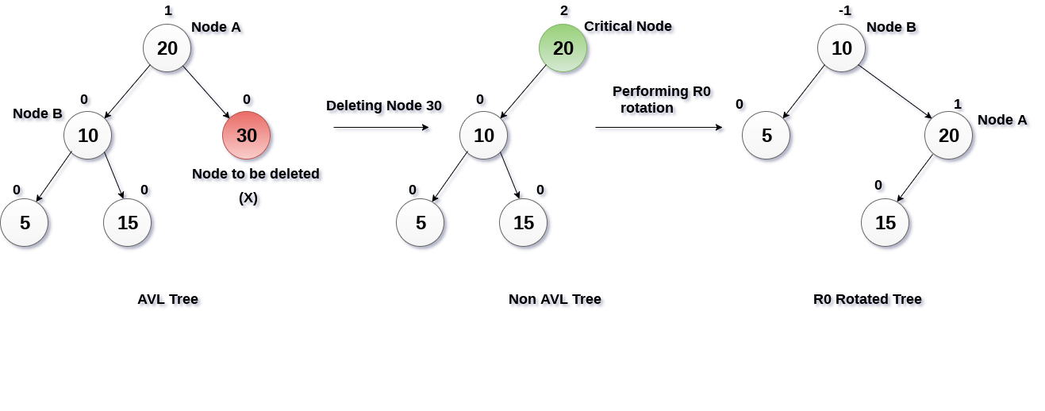
Example R 0

Slide 17
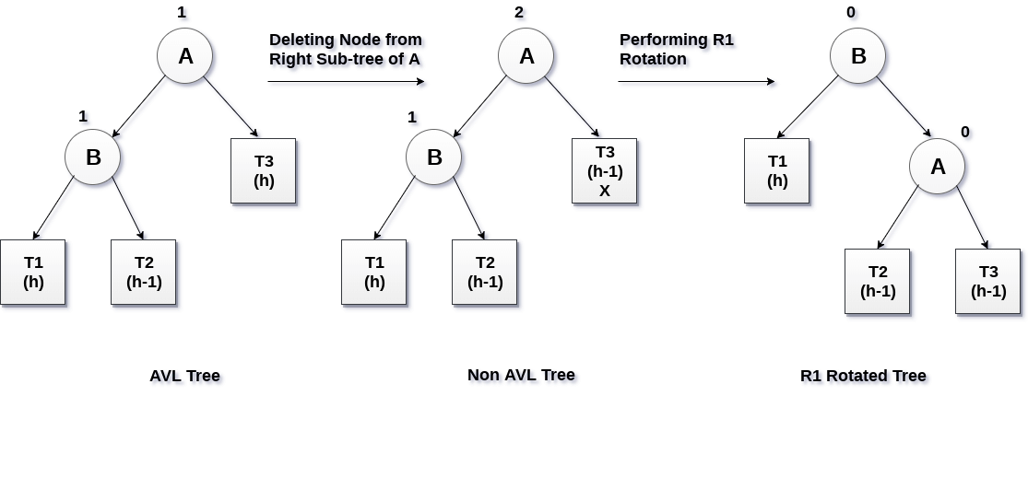
R1 Rotation (Node B has balance factor 1)
R1 Rotation is to be performed if the balance factor of Node B is 1.
In R1 rotation, the critical node A is moved to its right having sub-trees T2 and T3 as its left and right child respectively. T1 is to be placed as the left sub-tree of the node B.
R1 → LL Case → Right Rotation at critical node

Slide 18
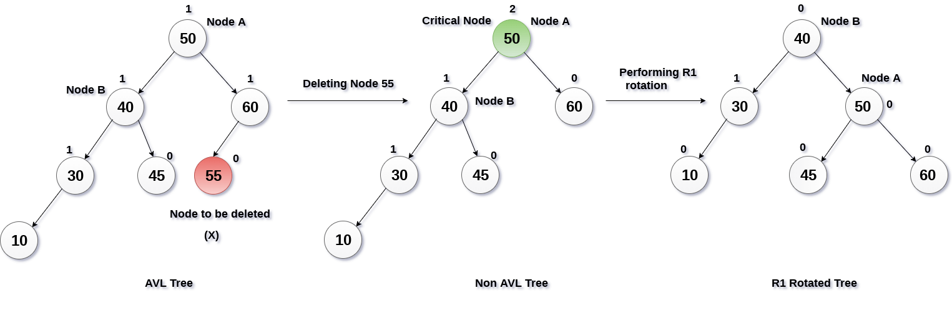
Example R 1

Slide 19
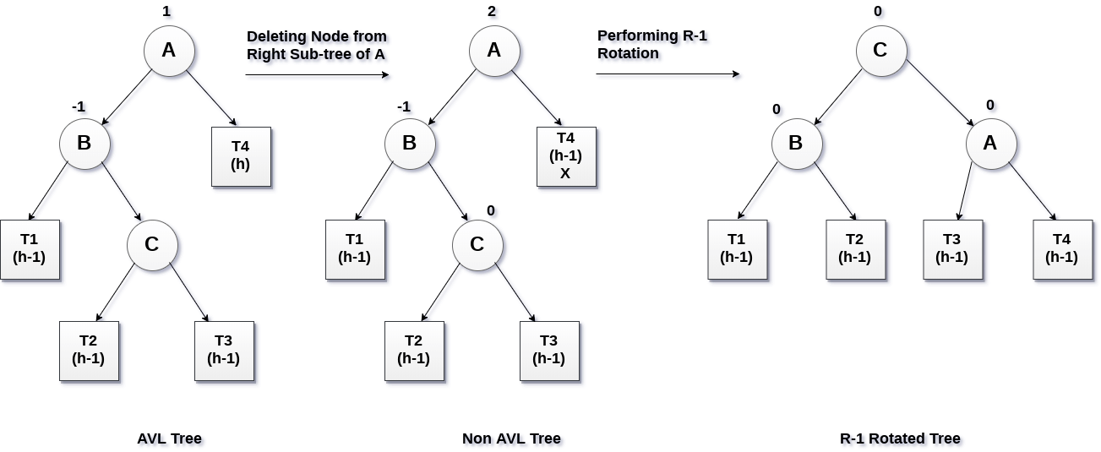
R -1 Rotation (Node B has balance factor -1)
R-1 rotation is to be performed if the node B has balance factor -1.
This case is treated in the same way as LR rotation.
In this case, the node C, which is the right child of node B, becomes the root node of the tree with B and A as its left and right children respectively.
R-1 → LR Case → Left Rotation at B and then Right Rotation at critical node(A)

Slide 20
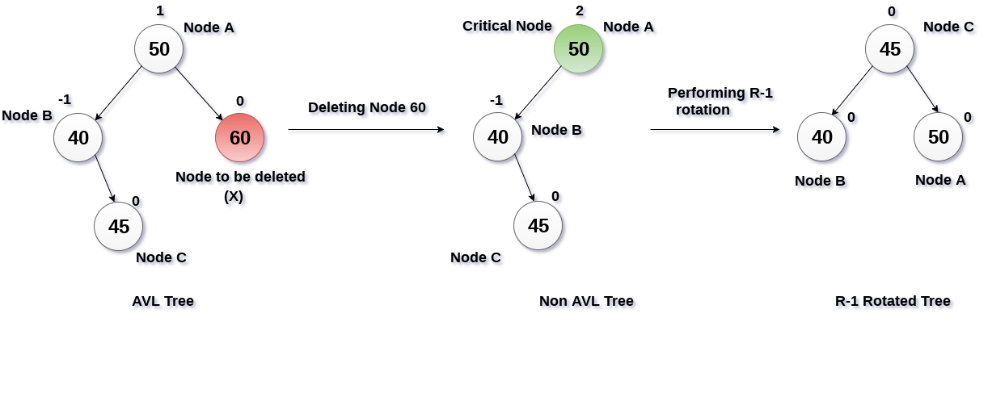
Example R-1

Slide 21
Summary
In deletion of any node in AVL tree, The two types of rotations can be made .
They are L rotation and R rotation.
As R rotations are discussed in previous slide. L rotations are the mirror images of them.
R rotations
R0 → LL Case
R1 → LL case
R -1 → LR case
L rotations
L0 → RR Case
L1 → RR Case
L -1 → RL Case
{Note – for rotation check previous Balance factor with sibling}

Slide 22
Rules of Rotation
IF using L-R for balancing Factor, then
R - Rotations L - Rotations
R0 = LL Case L0 = RR Case
R1 = LL case L1 = RR Case
R -1 = LR case L -1 = RL Case
IF using R - L for balancing Factor, then
R - Rotations L - Rotations
R0 = LL Case L0 = RR Case
R -1 = LL case L-1 = RR Case
R 1 = LR case L1 = RL Case

Slide 23
Construct AVL Tree
Insert
12, 19, 17, 6, 18, 13, 25, 36, 80
Delete
17, 6, 18, 12

Slide 24
Construct AVL Tree
Insert
14, 11, 19, 7, 12, 17, 53, 4, 8, 13, 20, 60, 70
Delete
8, 7, 11, 14, 17

